Slide 1
Detecting LSB Steganography in Colour and Grayscale images
Team Photons
Roll number Name Program
2019201016 Shivani Hanji MTech CSE
2019201070 Saptarshi Manna MTech CSE
2019201074 Pratikkumar Bulani MTech CSE
2019201089 Dhawal Sirikonda MS CSE
Mentor TA: Soumyasis Gun
Repo URL: https://github.com/Digital-Image-Processing-IIITH/project-photons

Slide 2
Overview
Paper
Detecting LSB Steganography in Color and Grayscale Images (2001)
Jessica Fridrich, Miroslav Goljan, and Rui Du
Problem Description
Detecting whether an image contains a hidden message and estimating its length using RS steganalysis

Slide 3
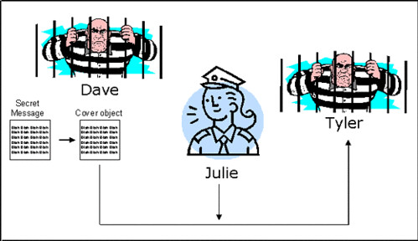
Steganography
Hiding data in data (in both cases, it could be an image, text, audio, video, etc)
The message is usually encrypted before hiding it, although it can also be hidden as plaintext
Steganalysis
Trying to detect secret data that may be hidden in some other data
It is not necessary to be able to read the secret message to “break” a steganographic system
PRESIDENT'S EMBARGO RULING SHOULD HAVE IMMEDIATE NOTICE. GRAVE SITUATION AFFECTING INTERNATIONAL LAW. STATEMENT FORESHADOWS RUIN OF MANY NEUTRALS. YELLOW JOURNALS UNIFYING NATIONAL EXCITEMENT IMMENSELY.
Taking the first letter of every word:
PERSHING SAILS FROM NY JUNE I

Slide 4
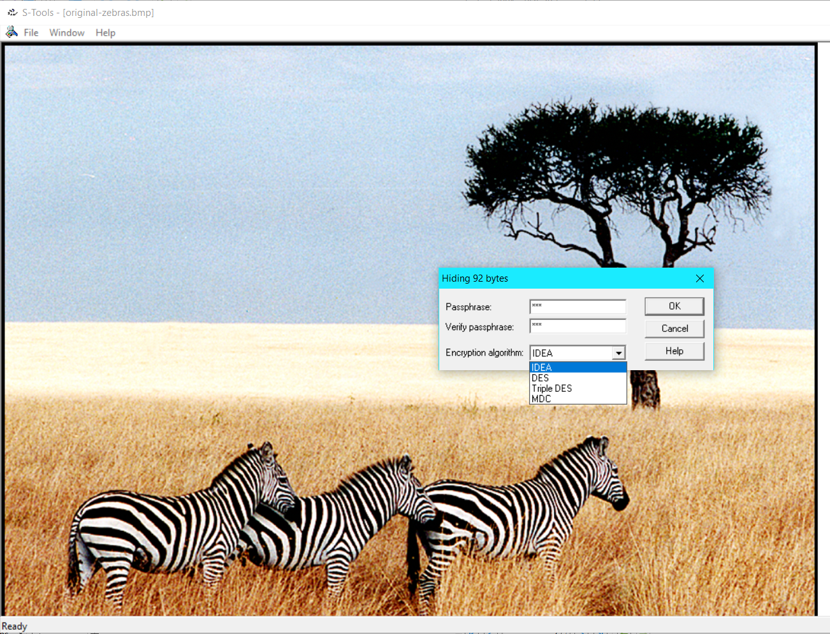
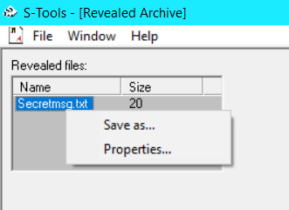
Steganography - software / tools
Example:
Using S-Tools to communicate secretly by encrypting and hiding a message in an image

Slide 5
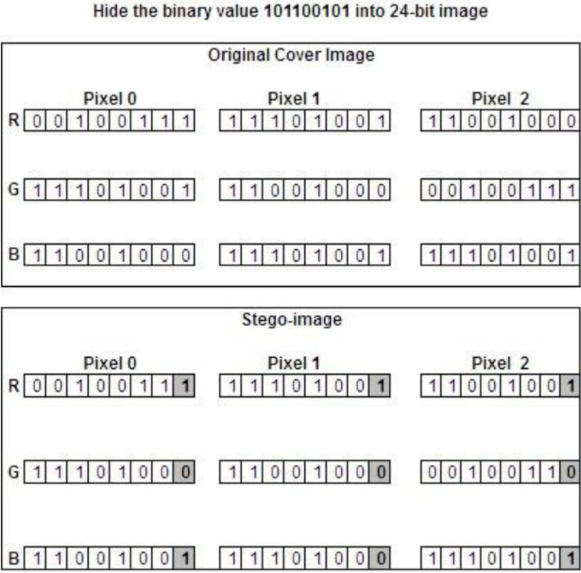
An example of
LSB steganography
LSB steganography is a common steganographic approach in which the message bits are stored in the LSBs of an image (LSB embedding)

Slide 6
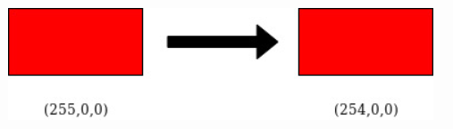
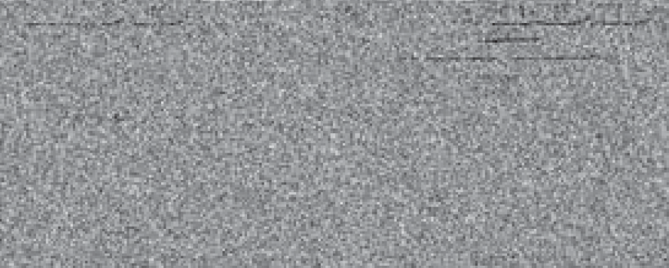
Why are LSBs usually used to hide a message?
The change in colour is undetectable for the human eye
11111111
11111110
Also, for most images, the LSB plane is essentially random
and does not contain any easily recognizable structure
Notes:
Not visually perceptible

Slide 7
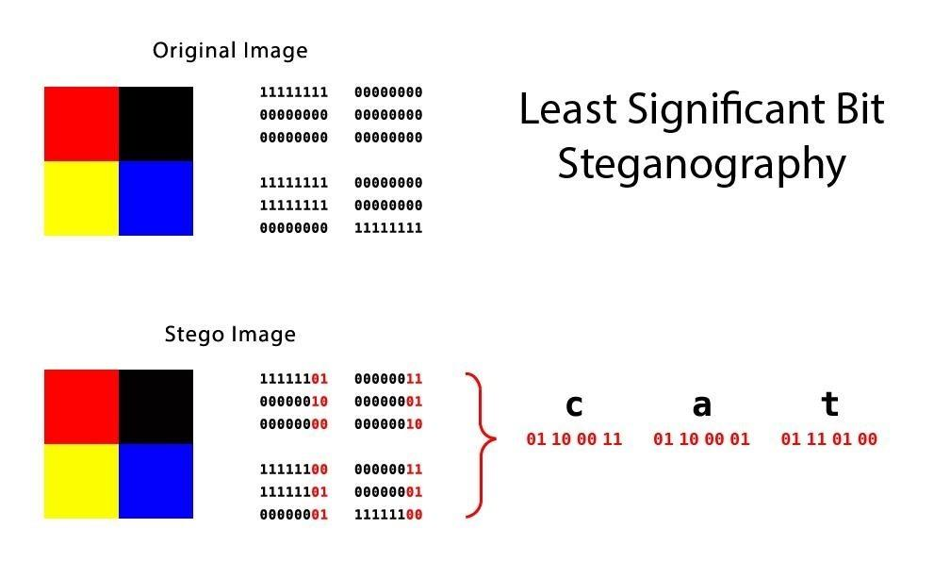
Why are LSBs usually used to hide a message?

Slide 8
Scope
Detecting the percentage of LSBs that have been flipped in an image (helps to estimate the length of the hidden message)
Not uncovering the hidden message itself (If the hidden message is in the form of ciphertext, this would require cryptanalysis)

Slide 9
RS Steganalysis
A statistical technique that was developed mainly to detect a message scattered across the LSBs of randomly chosen pixels in a stego-image (doesn’t work so well for sequentially embedded messages)
This technique does not depend on the specific algorithm that may have been used for steganography
3 main ideas discussed in the paper:
Obtaining RS diagram from empirical experimentation on original cover images
Method to estimate RS curves from a (potentially) stego-image
Estimating the length of the hidden message and checking its accuracy

Slide 10
Procedure to obtain RS diagram
Image is divided into disjoint groups of adjacent pixels
Discriminaton function measures the smoothness of a group of pixels
Flipping functions ( F₀ , F₁ , F₋₁ ) flip the LSB of a single pixel
For every group, check the discrimination function’s value before and after flipping
A mask M is created to apply flipping functions to a group of pixels
Calculate the percentage of regular groups (R), singular groups (S) and unusable groups (U)
We will see how the number of regular groups and singular groups change with LSB randomization (for example, LSB steganography)

Slide 11
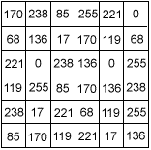
RS Steganalysis - Discrimination function
It measures the smoothness / regularity of a group of pixels
Noisy group → higher value of discrimination function
The pixels within a group are traversed in a zigzag manner to evaluate the discrimination function. This ensures that neighboring pixels are listed together
|170 - 238| + |238 - 68| + |68 - 221| + |221 - 136| + |136 - 85| + |85 - 17| + |17 - 0| + |0 - 238|
= 68 + 170 +153 + 85 + 51 + 68 + 17 + 238
= 850

Slide 12
RS Steganalysis - Flipping functions
1 | 0 | 1
0 | 1 | 0
1 | 1 | 0
171 | 238 | 84
68 | 137 | 17
220 | 1 | 238
=
Negative Mask
-1 | 0 | -1
0 | -1 | 0
-1 | -1 | 0
169 | 238 | 86
68 | 135 | 17
222 | -1 | 238
=

Slide 13
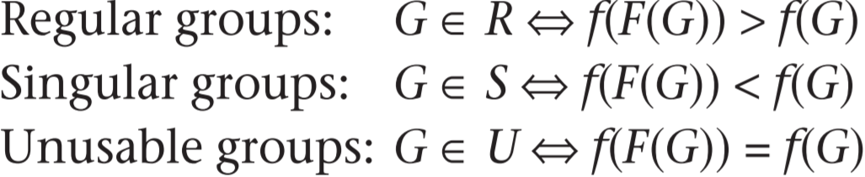
RS Steganalysis - Regular and Singular groups
R_{M} denotes the percentage of regular groups in the image using mask M
R_{-M} denotes the percentage of regular groups in the image using mask -M
S_{M} denotes the percentage of singular groups in the image using mask M
S_{-M} denotes the percentage of singular groups in the image using mask -M
As per the statistical hypothesis, for the original cover image,
R_{M} ≅ R_{-M} and S_{M} ≅ S_{-M}
R_{M} >> S_{M}

Slide 14
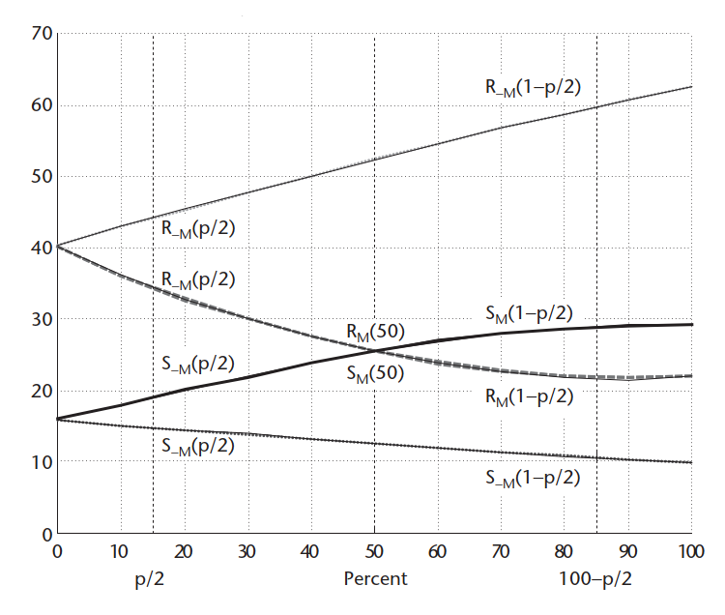
RS Steganalysis - RS diagram
The authors collected experimental evidence that
R_{−M} and S_{−M} are modeled well by straight lines, while
R_{M} and S_{M} are modeled well by second-degree polynomials
The principle of RS steganalysis is to estimate
the four curves of the RS diagram for a stego-image, and calculate their intersection using extrapolation.
p = Length of the message expressed as a percentage of the total image pixels
p/2 = Percentage of LSBs flipped by a message of length p, on an average
1-p/2 = The percentage of LSBs which are flipped (as compared to the original cover image), when all the LSBs are flipped in a stego-image
RS-diagram of an image. The x-axis is the percentage of pixels with ﬂipped LSBs, the y-axis is the relative number of regular and singular groups with masks M and −M. Here, M = [0 1 1 0]

Slide 15
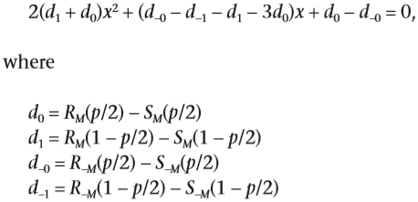
RS Steganalysis - Extrapolation and Length Estimation
The x-coordinate of the intersection point of R_{M} and S_{M} is given by a root of the quadratic equation
The message length p can be estimated using

Slide 16
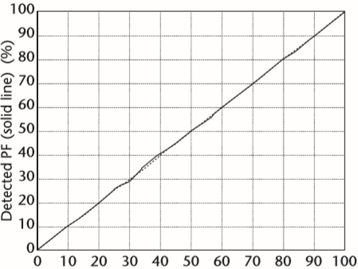
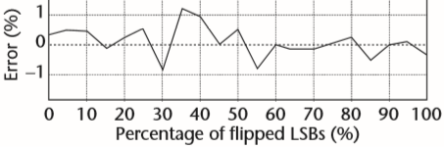
RS Steganalysis - Extrapolation and Length Estimation
The error between detected p and actual p
(detected % of flipped pixels v/s actual % of flipped pixels), as observed by the authors:
The accuracy of length estimation is affected by:
Initial bias
Non-zero message length detected in an original cover image
Noise
In noisy images, the difference between R_{M} and S_{M} is small
Message placement
More accurate for randomly scattered messages than sequential / locally concentrated messages

Slide 17
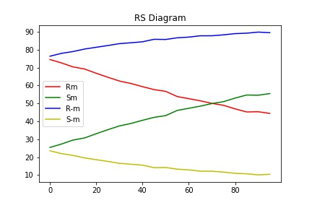
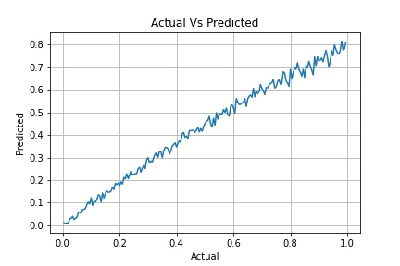
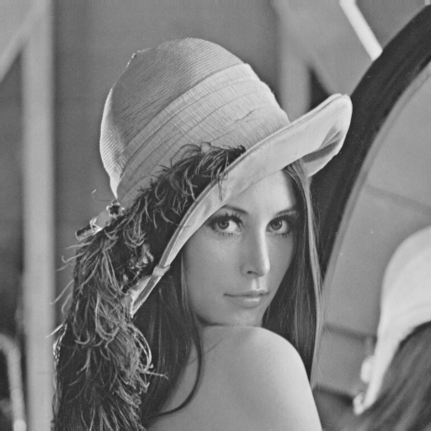
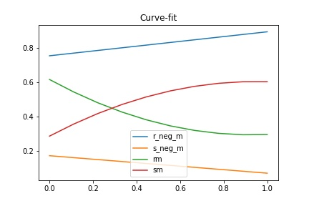
RS Steganalysis - Our result

Slide 18
Contribution
Difficult to define clear-cut task boundaries as we regularly had meetings that lasted for hours and coded together.
Understanding the literature of the paper was pretty hard as the equations were without explanations and had to fiddle around lot of literature to get to a proper understanding for the implementation.
Finding Initial Bias and Finding roots caused hurdles as the proof was not provided.
Roughly:
Pratik Bulani - Discrimination Function, Flipping Operations, Counting R and S groups
Shivani Hanji - Finding roots of extrapolation equation, Polynomial fitting, Experimenting with RS diagram
Dhawal S - Counting R and S groups, Scattered LSB flipping, Curve Fitting
Saptarshi - Scattered LSB Flipping and Zigzag mask for discrimination Function, Actual Vs Predicted steg-testing

Slide 19
Contribution (cont.d) - Experimentation
(Done by all team members)
Testing with S tools and Stepic (steganography software)
Experimenting with different Masks
Testing with (SimpleLSBFlipping) Sequential Flipping vs Random Scattering Flipping.
Tried various ways of finding roots of quadratic equation and fitting the quadratic curve on the points
Different ways to integrate Color channels in the existing procedure for grayscale
Tested with homogenous images (with very less variation in color intensity) to check the R,S,U groups.
Researched various ways to find the R_{M}(½) and S_{M}(½)
Tested with various images to check the graph of actual p vs predicted p
Tested various formats of images for generating RS diagram
1980 .bmp mislead us. Check the link: https://image.online-convert.com/convert-to-bmp

